Slide 1
Smart Air Quality (AQI) Monitor
NAME:-LALIT KUMAR
COURSE:-MCA CLOUD TECHNOLOGY AND DEVOPS
SEM=1ST SEMESTER
COLLEGE NAME:-POORNIMA UNIVERSITY JAIPUR
GUIDE NAME:-NIKITA JANGID

Slide 2
INTRODUCATION
To bridge the gap between raw environmental data and human health by creating an intelligent Air Quality Monitor. The goal is to not just display pollution numbers, but to interpret them into life-saving advice—such as mask recommendations and exposure limits—helping the community combat the rising threat of air pollution effectively.“

Slide 3
Problem Statement
Solves Data Complexity: It addresses the problem where raw pollution numbers (AQI) are confusing for the general public by translating them into simple, clear health advisories.
Protecting Public Health: It is important because it provides real-time, actionable warnings (like "Wear a mask") that help vulnerable groups avoid respiratory illnesses and stay safe.

Slide 4
Objectives
Project Goal: To develop a real-time AQI monitoring system that translates complex pollution data into visual insights and actionable health advisories to protect public safety.
Optimization Target: To automate data fetching and database storage using background threads while implementing API caching to ensure high performance and reduced latency

Slide 5
Proposed Solution
System solves the problem-The system solves the problem of ambiguity in air pollution data by acting as an intelligent translator. Instead of just displaying raw numbers (like AQI 180), it instantly maps real-time data to specific health risks and actionable advice (e.g., 'Mask Mandatory'). This eliminates guesswork and empowers users to take immediate protective measures for themselves and vulnerable groups.

Slide 6
High-level strategy
"Our strategy utilizes a Decoupled Full-Stack Architecture to ensure speed and reliability.
Data Aggregation: We leverage the robust OpenWeatherMap API for global accuracy rather than building hardware sensors.
Asynchronous Processing: The Python backend uses multi-threading to handle complex tasks—fetching data, processing health logic, and saving history to the database—simultaneously, ensuring the user interface remains instant and lag-free."

Slide 7
Technologies Used
Frontend (UI/UX): Built using standard HTML, CSS, and JavaScript. Integrated Chart.js for the forecast graphs and Leaflet.js for the interactive maps.
Backend (Logic): Powered by Python and the Flask framework to handle server requests and processing.
Database (Storage): Utilized SQLite to store and retrieve user search history locally.
Cloud/API (Data Source): Leveraged the OpenWeatherMap Cloud API to fetch real-time global air quality data

Slide 8
Features
Live AQI Tracking: Real-time global data.
Health Advisory: Actionable alerts (Masks/Indoors).
Visual Analytics: Interactive Gauge & Forecast Graph.
Location Mapping: Pinpoint city on a map.
Search History: Auto-save to local database.
Export Data: One-click CSV download.

Slide 9
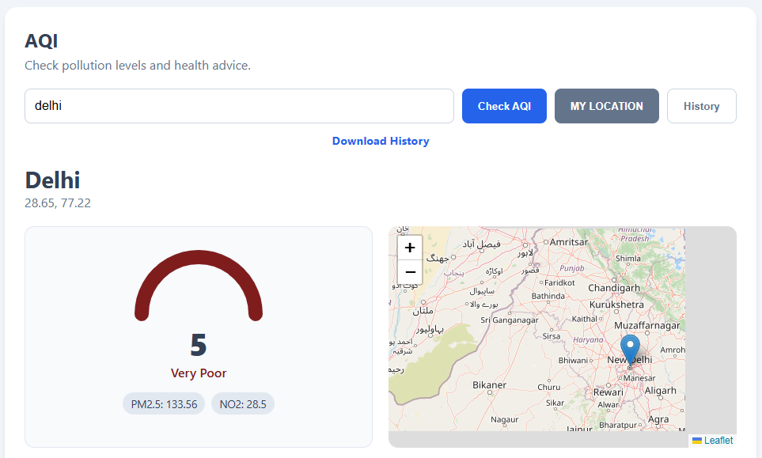
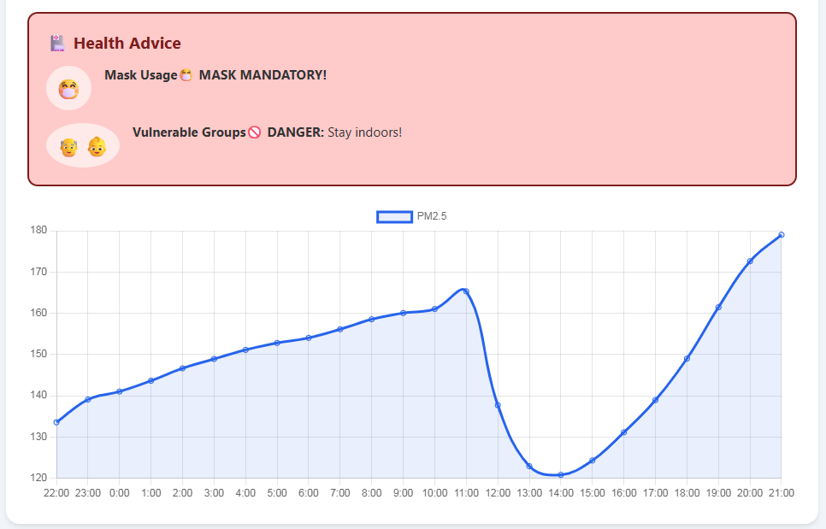
Screenshots

Slide 10
Code Highlights
from flask import Flask, request, jsonify, send_from_directory, Response
import os, time, threading, sqlite3, csv, io
import requests
from datetime import datetime
from flask_cors import CORS

Slide 11
Results
High Performance & Cost Efficiency: The backend implemented API Caching and Asynchronous Threading, which ensures near-instantaneous search results for the user while dramatically reducing external API call costs and keeping the system lag-free.
Reliable Data Integrity: The system successfully created a persistent, portable SQLite Database that auto-saves all user history, enabling features like one-click CSV/Excel export for external data analysis.

Slide 12
Future Enhancements
Email Alert System: Integrate automation to send instant email warnings when the AQI reaches hazardous levels.
Predictive Analytics: Use Machine Learning to forecast pollution trends for the upcoming week.
IoT Integration: Develop connectivity to physical sensors for hyper-local and indoor air quality monitoring.
User Personalization: Allow users to save favorite cities and set personalized alert thresholds.

Slide 13
Conclusion
This project successfully developed a full-stack Air Quality Monitor that translates complex data into simple, actionable health advice. The system is highly efficient, using Python threading and API caching to ensure instant, lag-free performance. It successfully bridges the gap between raw environmental data and public safety, providing a scalable solution for promoting health awareness.

Slide 14


